Slide 1


GitOps Meets Frontend: How React ChatBotify Simplifies Theme Delivery
Tan Jin | Platform Engineer

Slide 2
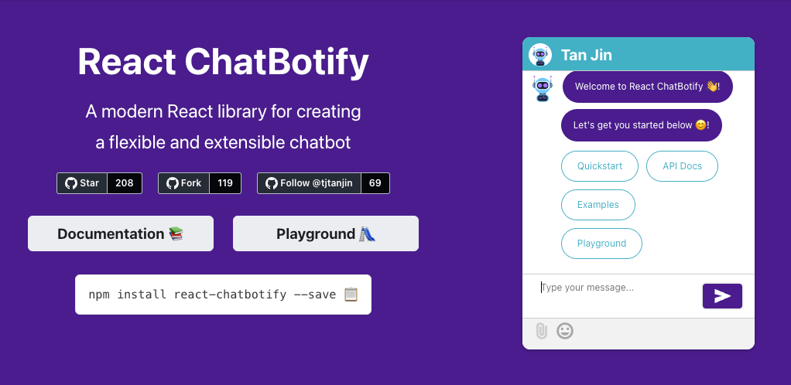

What is React ChatBotify?

Slide 3
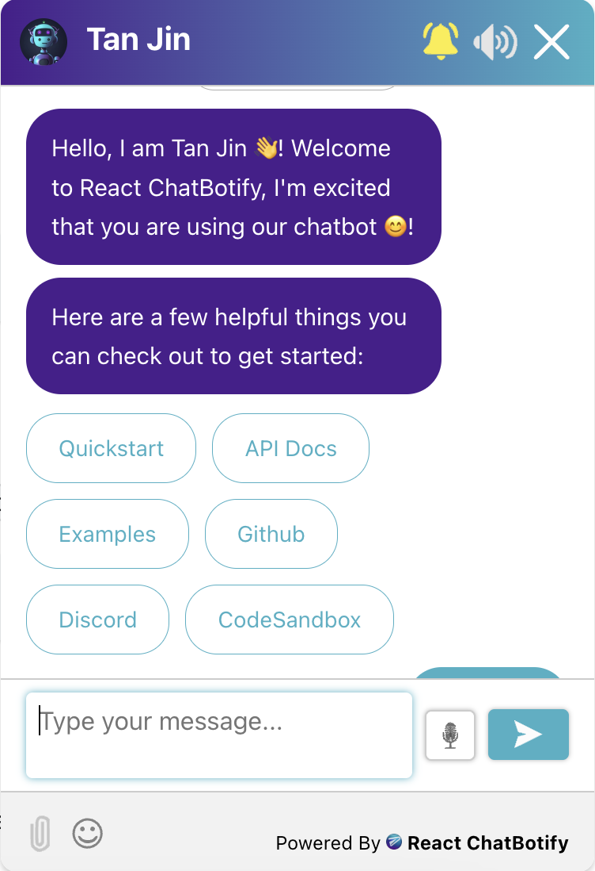
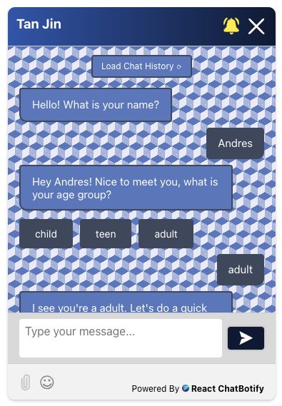
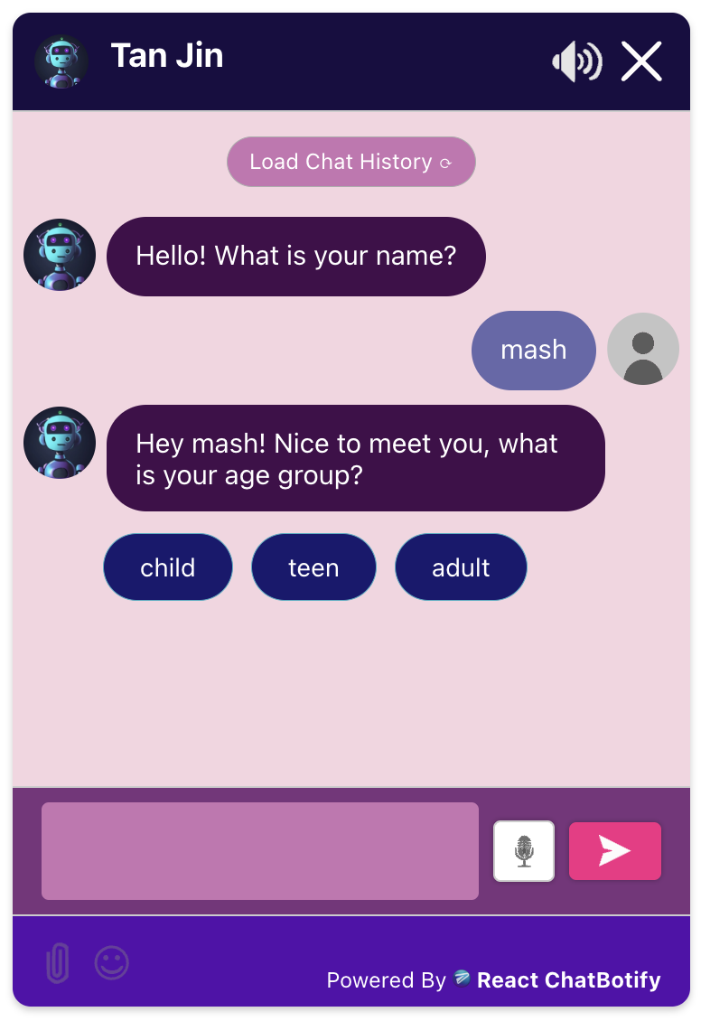
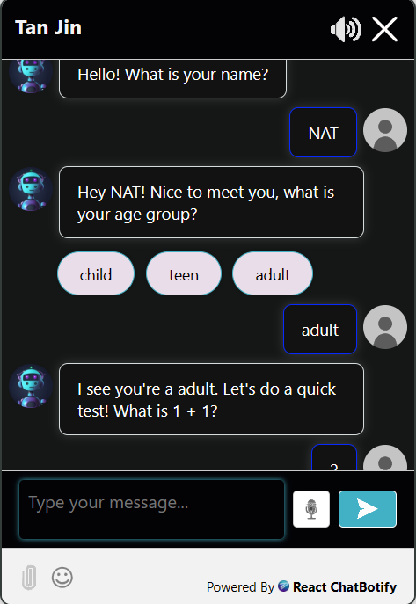
Themes

Slide 4
Naive Solutions
Solutions | Advantages | Disadvantages
Pre-make themes and add them directly inside the chatbot library | Straightforward, simple to implement Easy to use, users simply specify the theme to be loaded | Unsustainable, library bloats overtime Redundant package updates for all users
Create a themes extension pack | Mitigates library bloat | More implementation and maintenance effort Additional steps for users to install extension Redundant package updates for theme users

Slide 5




What is GitOps?
Infra as Code (IaC)
Git
Automation
Application State
Config as Code (IaC)

Slide 6



A GitOps-Inspired Solution
Themes Config as Code
GitHub
JsDelivr

Slide 7
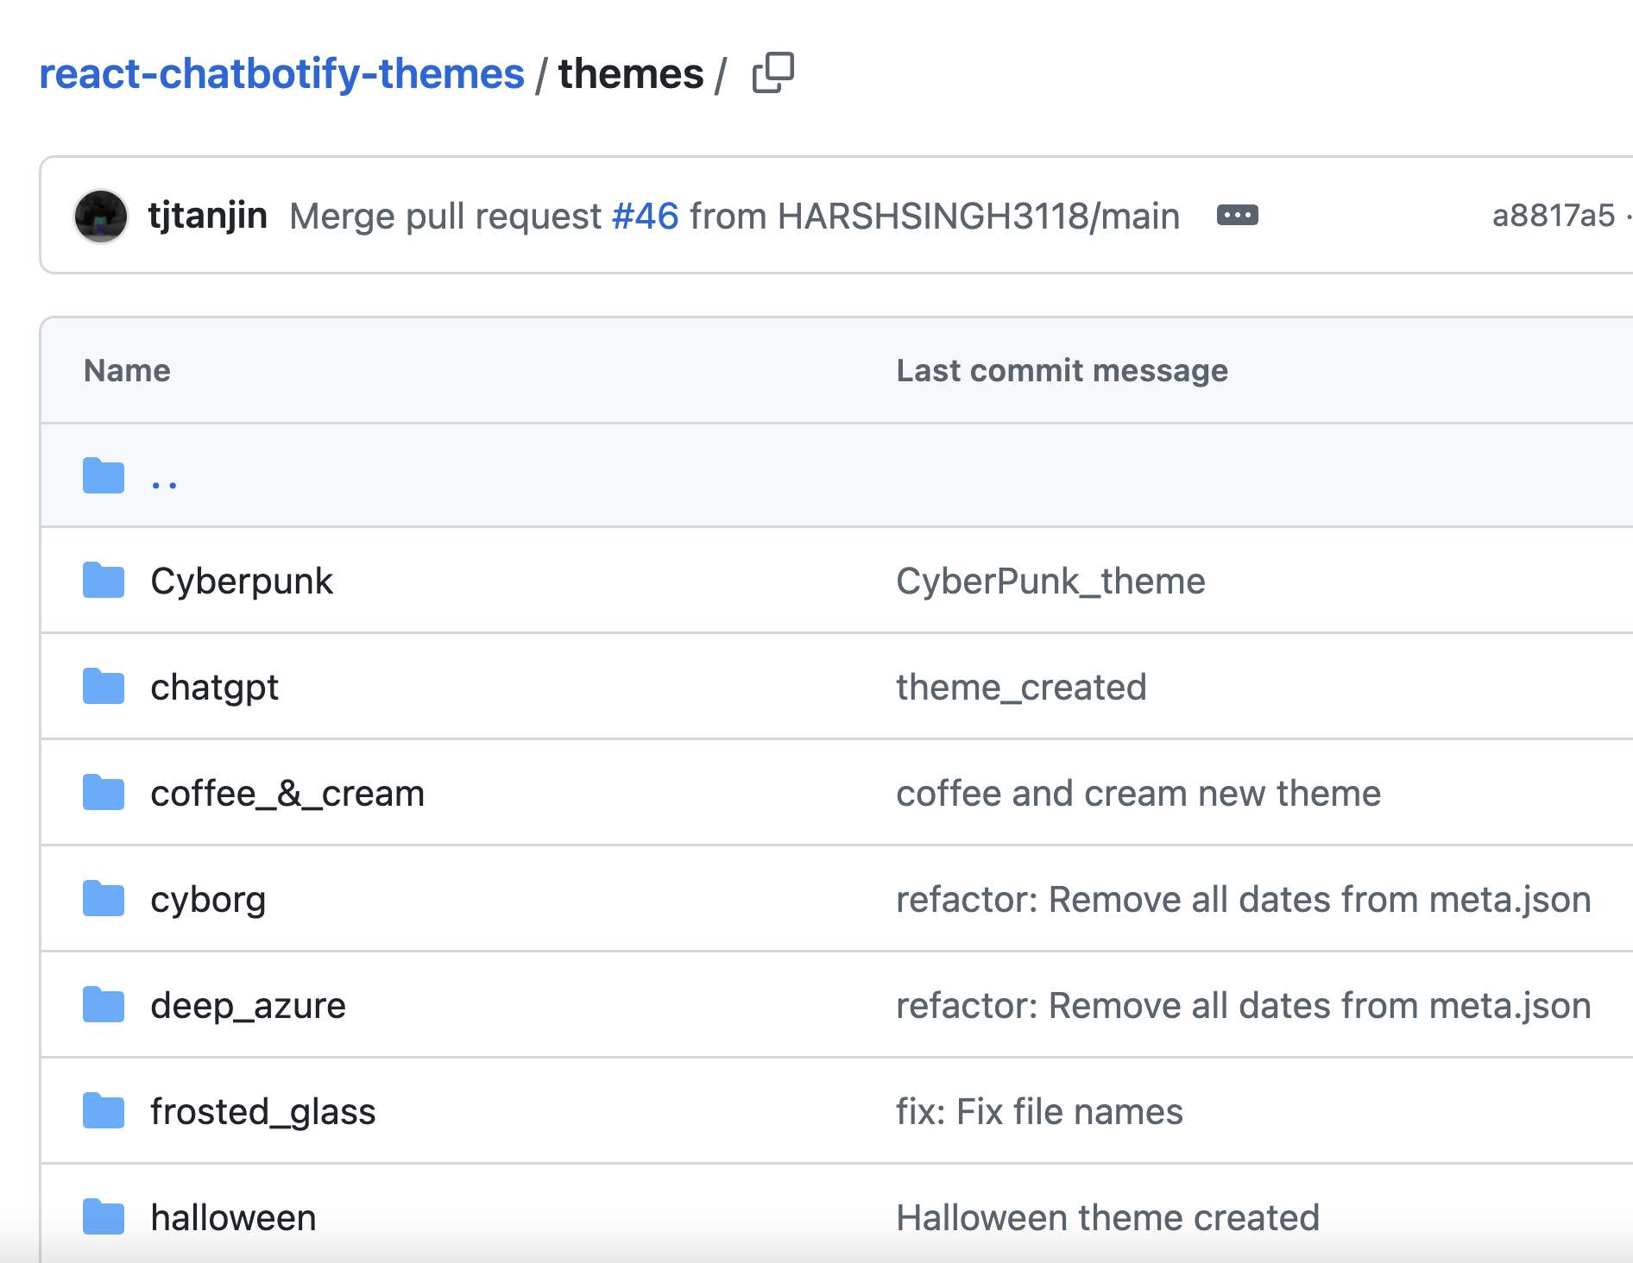
A GitOps-Inspired Solution
Advantages:
Vastly improved user experience
Mitigated library bloat
Easy to use
Encourages open-source contributions
Disadvantages:
Additional one-time effort to setup the themes repository

Slide 8

Thank You!
Tan Jin | Platform Engineer

